Slide 1
Angular - Services
Peter Eijgermans peter.eijgermans@ordina.nl

Slide 2
Services
Target – make data functionality reusable for different components:
Data retrieval, Data caching, Data Storage

Slide 3
Singleton?
Services are singletons
They are a singleton for the Module and all child components.
Module/Site-wide usage?
Instantiate the service in app.module.ts
4

Slide 4
Data flow
View
{{…}}
Class / Component
Service
Save your data via Http
API → Database

Slide 5
Data flow
View
{{…}}
Class / Component
Service
View
{{…}}
Class / Component

Slide 6
Why use a Service?
Make data functionality reusable for different components
Data functionality available for all components
Data will be available when you switch from component/view
(components are volatile to “share” data)
Contains logic that is not directly related to the view!!!

Slide 7
Basic Rule Service
Put all your (business)logic in the service !
The Component should be lean and mean !

Slide 8
Services in Angular
Data services in Angular:
import {Injectable} from '@angular/core';
@Injectable({ providedIn: 'root' })
export class CityService{
//....
}
Notes:
The @Injectable() decorator marks it as a service that can be injected

Slide 9
Steps to make a Service
Step 1 – create a service
Step 2 – consume/inject service in component
Step 3 – inject service in Module (app.module.ts)

Slide 10
Step 1 – service (static data)
import { Injectable } from '@angular/core'; import { City } from './city.model'; @Injectable({ providedIn: 'root' }) export class CityService { public cities: City[] = [ new City(1, 'Groningen', 'Groningen'), ]; // retourneer alle cities public getCities(): City[] { return this.cities; } // retourneer city op basis van ID public getCity(id: number): City { return this.cities.find(c => c.id === id); } }

Slide 11
Step 2 – Service consume/inject
import { CityService } from './city.service'; @Component({ selector: 'hello‐world', templateUrl: 'app/app.html', }) export class AppComponent implements OnInit { // Properties voor de component/class public currentCity: City; public cities: City[]; public cityPhoto: string; constructor(private cityService: CityService) {} public ngOnInit(): void { this.cities = this.cityService.getCities(); } public getCity(city: City): City { this.currentCity = this.cityService.getCity(city.id); this.cityPhoto = `img/${this.currentCity.name}.jpg`; console.log('City opgehaald:', this.currentCity); } }
Constructor: shorthand voor nieuwe private variable + instantiering!
local variables
Detailgegevens voor city bij (click) event

Slide 12



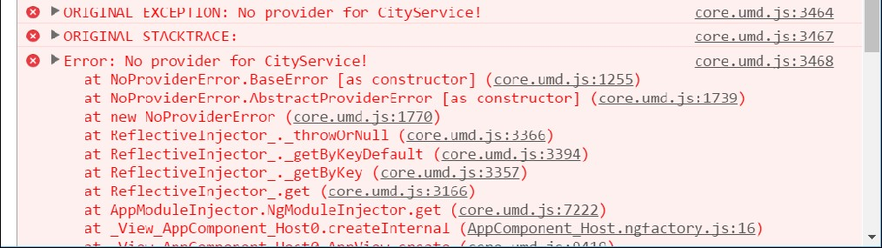
“No provider for CityService”
Solution: inject in app.module.ts

Slide 13
Step 3 – Inject service in Module (app.module.ts)
Use the annotation providers:[ … ]
// Module declaration
@NgModule({
imports : [BrowserModule], declarations: [AppComponent],
bootstrap providers
: [AppComponent],
: [CityService, GoogleService] // DI voor service
})
export class AppModule {
}
Array met Service- dependencies

Slide 14
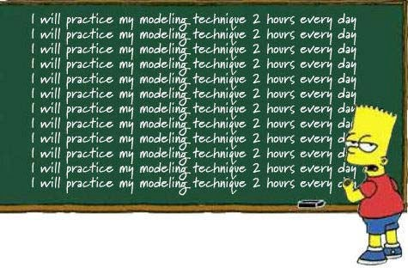
Checkpoint
See 5a
Exercise….

Slide 15
Async services

Slide 17
Async Services
Work with HttpClient: asynchrone actie
AngularJs: Promises
Angular : Observables
Use in Angular : ReactiveX library RxJS

Slide 18

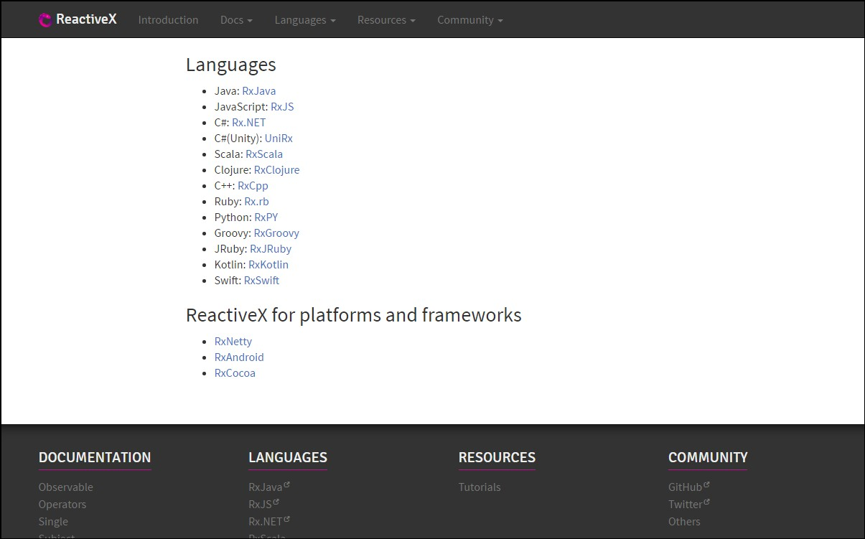
http://reactivex.io/

Slide 19
Observable
Subscribe
Notes:
You are a Observer = Listener and Subscriber on the data
TV is the Observable = Provider of Async data

Slide 20
Observable
Returns a stream of values over time

Slide 21


Slide 22
Observable
Cancelable
Returns a stream of values over time
Lazy
Subscribe to the stream (push mechanism)
Array-methods on stream → map(), filter(), reduce()
Notes:
Lazy: er gebeurt niks met de ontvangen stream, totdat hij aangeroepen wordt
Observable is te vergelijken met een array, die langzamerhand gevuld wordt met data.
Omdat een observable zich gedraagd als een array, zijn allerlei array methods beschikbaar, zoals: map(), filter(), reduce()
Example stream: list of ’share prices’ which changes each minute.

Slide 23
Interactive diagrams of Rx Observables
http://rxmarbles.com/
RXFiddle.net

Slide 24
Async services
App, met
View
Webserver, met API &
Database
Internet
Controller
Ajax-call, met Http
Service

Slide 25
Example Http / cities.json
Make a data-file: cities.json
"cities": [
{
"id": 1,
"name": "Groningen",
"province": "Groningen",
"rating": 0,
"highlights": "Martinitoren"
},
…
]

Slide 26
Step 1 - Inject HttpClient in Service
import { Observable } from 'rxjs'; import { HttpClient } from '@angular/common/http'; @Injectable() export class CityService { constructor(private http: HttpClient) {} // retourneer alle cities public getCities(): Observable<City[]> { return this.http.get<City[] >('app/cities.json'); } }
Maak lokale variabele http
Retourneer observable naar de Component

Slide 27
Step 2 – Change component
export class AppComponent implements OnInit { // Properties voor component/class public currentCity: City; public cities: City[]; public cityPhoto: string; constructor(private cityService: CityService) {} public ngOnInit() { this.cityService.getCities() .subscribe(cityData => { this.cities = cityData; }, err => console.log('FOUT: ', err), () => console.log('Getting cities complete')); } }
Data async ophalen en .subscribe() gebruiken

Slide 28
Step 3 – Change module
// Angular Modules
…
import {HttpClientModule} from "@angular/common/http";
…
// Module declaration
@NgModule({
HttpModule importeren en toevoegen
imports
: [BrowserModule, HttpClientModule],
declarations: [AppComponent],
bootstrap providers
: [AppComponent],
: [CityService] // DI voor service
})
export class AppModule {
}

Slide 29
More about Observables
Part of RxJs
subscribe() has 3 parameters:
success
▪
error
complete
this.cityService.getCities()
.subscribe(cityData => {
this.cities = cityData;
},
err => console.log(err),
()=> console.log('Getting cities complete...')
)

Slide 30
Checkpoint Async services
Oefening 5b)
Exercise….

Slide 31
How to import RxJs in your application?
import 'rxjs’;
import {Observable} from ‘rxjs’;
import {map, filter, delay, retry} from 'rxjs/operators';
Notes:
Piping. Resultaat van de een functie (retry, delay) dient als invoer voor de volgende functie.

Slide 32
PIPING
r
import rxjs operatoren
import { retry, delay } from 'rxjs/operators’; export class AppComponent implements OnInit { // Properties voor de component/class public currentCity: City; public cities: City[]; public cityPhoto: string; constructor(private cityService: CityService) {} public ngOnInit(): void { this.cityService.getCities() .pipe(retry(10), delay(2000)) .subscribe(cityData => { this.cities = cityData; }, err => console.log('FOUT: ', err), () => console.log('Getting cities complete')); } }
Data async ophalen en retry and delay als ophalen mislukt
Notes:
Piping. Resultaat van de een functie (retry, delay) dient als invoer voor de volgende functie.

Slide 33
RxJS-operators in the service
import { City } from '../model/city.model'; import { HttpClient } from '@angular/common/http'; import { catchError, tap } from 'rxjs/operators'; import { Observable, throwError } from 'rxjs'; @Injectable() export class CityService { constructor(private http: HttpClient) {} // retourneer alle cities public getCities(): Observable<City[]> { return this.http.get<City[]>('app/cities.json') .pipe( tap(cities => { console.log('this is my city', cities[0]); localStorage.setItem('KEY', cities[0]); }), catchError(err => throwError(err)) ); } }
import rxjs operatoren
Tap: Transform stream in de service
Tap for side-effects
Notes:
Tap is used for side effects: logging, localstorage. Manupilating the DOM

Slide 34
Checkpoint piping
See 5c
Exercise….

Slide 35
CRUD applicatie
POST
PUT
DELETE
GET
Notes:
https://blog.angularindepth.com/angular-question-rxjs-subscribe-vs-async-pipe-in-component-templates-c956c8c0c794

Slide 36
Adding a City
const headers = new HttpHeaders().set('Content-Type', 'application/json');
const HEADERS = {headers: headers};
addCity(cityName: string): Observable<City> {
const newCity = new City(null, cityName);
return this.http.post<City>( → <City> is return type
API_URL,
JSON.stringify(newCity),
HEADERS
)
}

Slide 37
Update a City
updateCity(city: City): Observable<City> {
return this.http.put<City>(
url + `/${city.id}`,
JSON.stringify(city),
headers)
}

Slide 38
Delete a City
deleteCity(city) {
return this.http.delete(url + `/${city.id}`)
}

Slide 39

CRUD application
Notes:
https://blog.angularindepth.com/angular-question-rxjs-subscribe-vs-async-pipe-in-component-templates-c956c8c0c794

Slide 40
Checkpoint CRUD applicatie
See 5d
Exercise….

Slide 41
Async pipe
.subscribe() versus | async
| Async also unsubscribes !!!
Notes:
https://blog.angularindepth.com/angular-question-rxjs-subscribe-vs-async-pipe-in-component-templates-c956c8c0c794

Slide 42
DEMO 206 services–async-pipe
<li *ngFor="let city of cities$ | async”>
{{ city.id}} - {{ city.name }}
</li>

Slide 43
Advantages Async pipe
No subscribe() needed
No unsubscribe() needed
Saves boilerplate code in component

Slide 44
Checkpoint async pipe
Start applicatie services–async-pipe
Oefening….

Slide 45
Live API’s
36

Slide 46
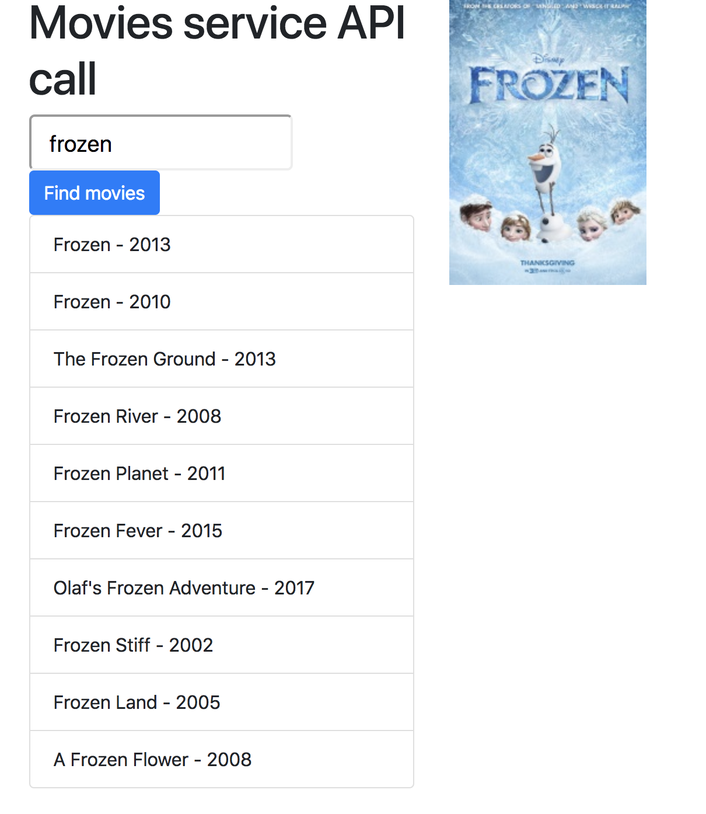
Movies services API call
210-Service Live
211-Service Live with mapping

Slide 47
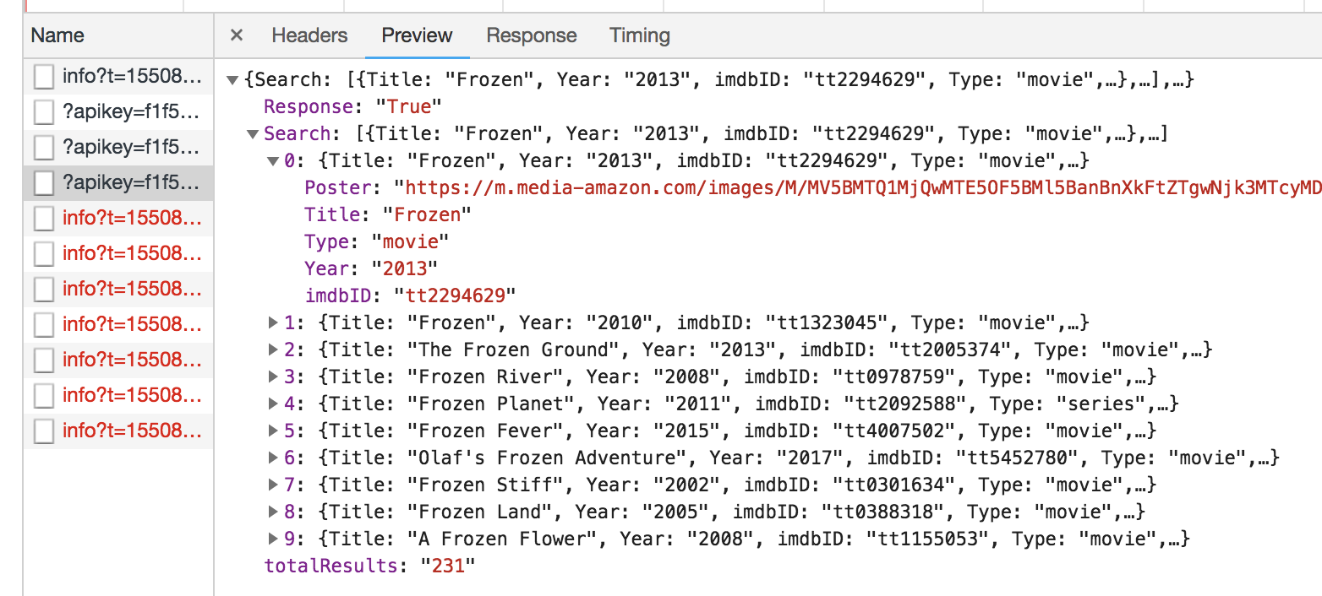

Slide 48
MovieModel
export class MovieModel{
constructor(public titel:string,
public jaar:string,
public afbeelding:string) {
}
}

Slide 49
Weather API

Slide 50
Weather API
Step 1: Get Weather Json
http://api.openweathermap.org/data/2.5/weather?units=metric&appid=8566d604cd9402b65394b034e52aa2af&q=Gouda
Step 2: Generate TypeScript interfaces from JSON
http://json2ts.com/
Step 3 Use the TypeScript interface in the C08-Application

Slide 51
Weather API app
See project: C08-services-live-weather

Slide 52
Voorbeeld API’s
http://openweathermap.org/API (weerbericht)
http://filltext.com/ (random NAW-gegevens)
http://ergast.com/mrd/ - Ergast Motor (F1) API
http://www.omdbapi.com/ - Open Movie Database
http://swapi.co/ - Star Wars API
Zie ook JavaScript APIs.txt met meer voorbeelden

Slide 53
Checkpoint
See 5e
Exercise….
38

Slide 54
RxJS advanced

Slide 55
Observers and Subscriptions
Observers are also called listeners (or consumers) as they can listen or subscribe to get the observed data.
Subscriptions are objects that are returned when you subscribe to an Observable. They contain many methods such as the unsubscribe() method that you can call to unsubscribe from receiving published values from the Observable.
From the official docs:
Subscription represents the execution of an Observable, is primarily useful for cancelling the execution.

Slide 56
What is a Subject in RxJS?
A Subject is a special type of Observable that observers can also subscribe to it to receive published values but with one difference: The values are multicasted to many Observers.
Subjects are also Observers i.e they can also subscribe to other Observables and listen to published data.
By default an RxJS Observable is unicast.
Unicast simply means that each subscribed observer has an independent execution of the Observable,
while Multicast means that the Observable execution is shared by multiple Observers.

Slide 57

RxJs switchMap vs mergeMap
Flatmap = MergeMap !!!
https://www.youtube.com/watch?v=qYdKmYp95Jg

Slide 58
ExhaustMap vs concatMap
https://www.youtube.com/watch?v=nh13_aPRQ0Q

Slide 59
concatMap, mergeMap, switchMap, exhaustMap, forkJoin
https://blog.angular-university.io/rxjs-higher-order-mapping/
How to choose the right mapping Operator?
if we need to do things in sequence while waiting for completion, then concatMap is the right choice
for doing things in parallel, mergeMap is the best option (flatMap is an alias for mergeMap!)
in case we need cancellation logic, switchMap is the way to go
for ignoring new Observables while the current one is still ongoing, exhaustMap does just that
forkJoin: Wait for Observables to complete and then combine last values they emitted.

Slide 60
Hot and Cold Observables
Unlike regular Observables, ‘Subjects’ are called hot.
A hot Observable starts emitting events even before any observer subscribes to it, which means observers may lose previous emitted values if they don’t subscribe at that right time
While cold Observables start emitting values when at least one observer is subscribed
See: https://www.youtube.com/watch?v=oKqcL-iMITY

